Slide 1
INTRODUCTION TO COMPUTERS
PRESENTED BY : RUSHMIKA (324103210041)
FACULTY : DR.K.ROHINI
DEPT : CSE

Slide 2
COMPUTER
A Computer is a electronic devices which accepts data as input and process it and gives information as output .
FULL FORM : COMMON OPERATING MACHINE PURPOSELY USED FOR TECHNOLOGICAL AND EDUCATIONAL RESEARCH .
INPUT
PROCESS
OUTPUT

Slide 3
GENERATIONS OF C0MPUTER
FIRST GENERATION (1940-1956) : Manufactured using thousands of vaccum tubes .
SECOND GENERATION (1956-63) : Madeup of transistors .
THIRD GENERATION (1963-1971) : Made up of integrated circuits .
FOURTH GENERATION (1980’S) : based on VLSI(very large scale integration)
FIFTH GENERATION (PRESENT) : Based on ULSI and AI ( artificial intelligence)

Slide 4
CHARACTERSTICS OF COMPUTER
ACCURACY
SPEED
VERSATILITY
DILIGENCE
AUTOMATION

Slide 5
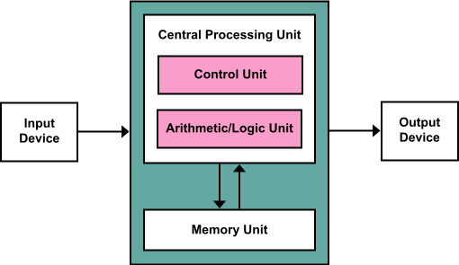
BASIC ORGANIZATION OF COMPUTER
A COMPUTER IS AN ELECTRONIC DEVICE
THAT PERFORMS 5 OPERATIONS
ACCEPTS DATA
STORING DATA
PROCESS DATA
OUTPUT
CONTROLLING

Slide 6
BASIC ORGANISATION OF COMPUTER
Accepts data ( input): The process of feeding the raw data into the computer for processing is known as input .
Storing data : There are two types of data storage .
Primary storage – RAM – The cpu can access the data from this storage. Stores data temporarily .
Secondary storage _ HDD , SSD –It stores data permanently . Less expensive .

Slide 7
BASIC ORGANISATION OF COMPUTER
Process data : It takes input from the users processes them and gives output . And for processing the cpu access the data from main memory and applies the instructions gives the output .
Output : it means giving the information after processing the data with instructions .
Controlling : the control unit controls the flow of data .
The ALU controls the Arthimetical and logical operations .

